Slide 1
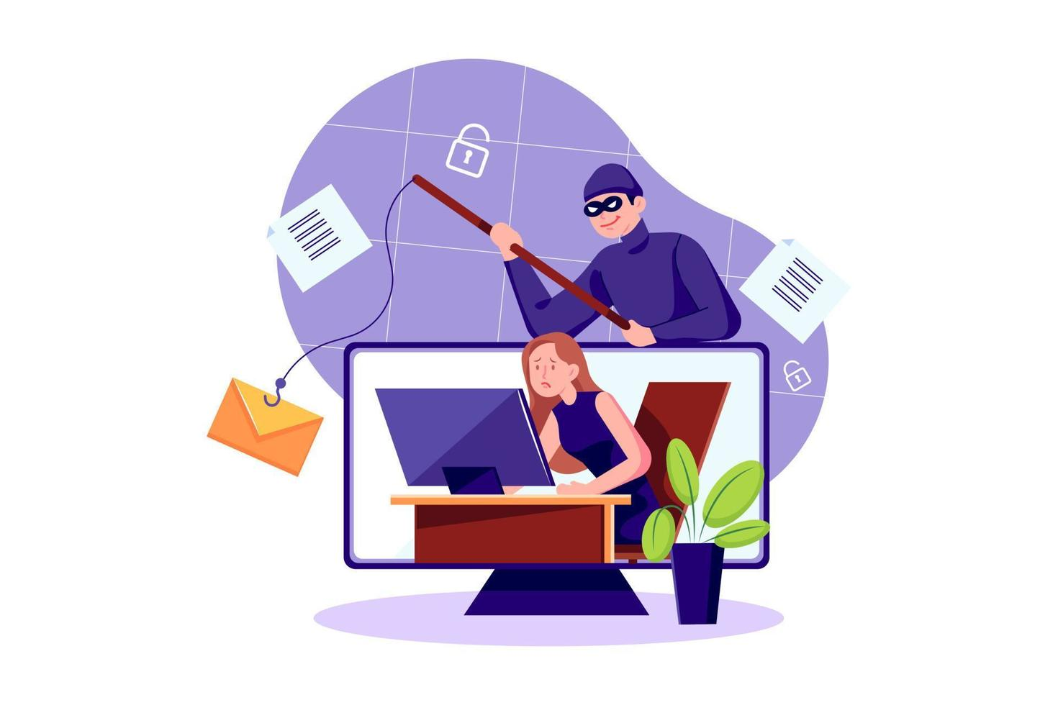
PROTECTING YOURSELF FROM PHISHING ATTACKS
Praxi paTEL

Slide 2
INTRODUCTION
Phishing is a type of social engineering attack often used to steal user data, including logical credentials and credit card number.
It is a cyber security attack that mostly uses disguised email as a weapon.
The goal is to trick the email recipient into believing that the message is something they want or need and to click a link or download an attachment.

Slide 3

The term “phishing” comes from the word “fishing,” because attackers are “fishing” for your personal data. They do this by sending fake messages, often through:
-> Email
-> Text messages (SMS phishing or "smishing")
-> Social media
-> Fake websites
-> Phone calls (voice phishing or "vishing")
These messages look like they come from legitimate sources like banks, social media platforms, or even your workplace, but they are actually fraudulent.

Slide 4
TYPES OF PHISHING ATTACKS
Social Engineering
Website Phishing
Email Phishing
Cleverly tricking people into sharing private information through tactics like impersonation and emotional appeals.
Crafting fake websites that look real to steal your login details and spread malware.
Sending sneaky emails designed to fool you into revealing sensitive info, like fake security alerts or account checks.

Slide 5
RECOGNIZING PHISHING EMAILS
Verify Email Content: Carefully read the email's message to identify any suspicious requests, urgent demands, or unusual language that might indicate a phishing attempt. Legitimate organizations rarely ask for sensitive information via email.
Hover Over Links to Preview URLs: Before clicking, hover your mouse over any links to see the actual web address. Check if the URL matches the official website and watch out for misspellings or strange domain names that could lead to malicious sites.
Check the Sender's Email Address: Examine the sender's email address closely. Phishers often use addresses that look similar to legitimate ones but may have subtle differences, such as extra characters or misspelled domain names.
Look for Spelling and Grammar Mistakes: Phishing emails frequently contain spelling errors, awkward phrasing, or poor grammar. These mistakes can be a red flag indicating the email is not from a trusted source.

Slide 6
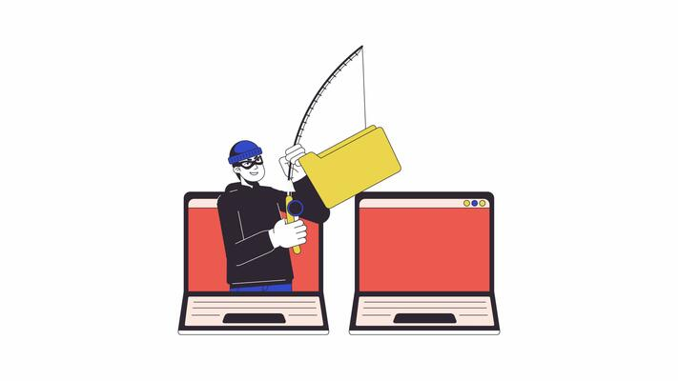
SOCIAL ENGINEERING TACTICS
Leveraging Emotional Responses.
Recognizing Manipulative Practices on Social Platforms.
Techniques for Identity Deception.
Exploiting the Dynamics of Trust.

Slide 7
PROTECT PERSONAL INFORMATION
Don’t email passwords Email is not secure for sharing passwords because messages can be intercepted or accessed by unauthorized people. Instead, use secure password managers or encrypted messaging apps to share sensitive login details safely.
Use two-factor login Two-factor authentication adds an extra security step beyond just a password. For example, after entering your password, you might receive a unique code on your phone or use a fingerprint scan. This makes it much harder for hackers to access your accounts.
Confirm sensitive info requests Always verify requests for personal or sensitive information by contacting the requester through a trusted method, like calling a known phone number. This helps prevent falling victim to phishing scams or fraudulent requests.
Share personal info carefully Be mindful about where and how you share personal details. Avoid posting your home address, phone number, or financial info on public websites or social media. Sharing only with trusted parties reduces the risk of identity theft or fraud.

Slide 8
BEST PRACTICES FOR AVOID PHISHING
Update software regularly to apply security patches and close vulnerabilities.
Use trusted security software to detect and block threats.
Train employees continuously to recognize phishing attempts and stay vigilant.
Conduct simulated phishing exercises to reinforce awareness.
Backup important data frequently and store backups securely to enable quick recovery.

Slide 9
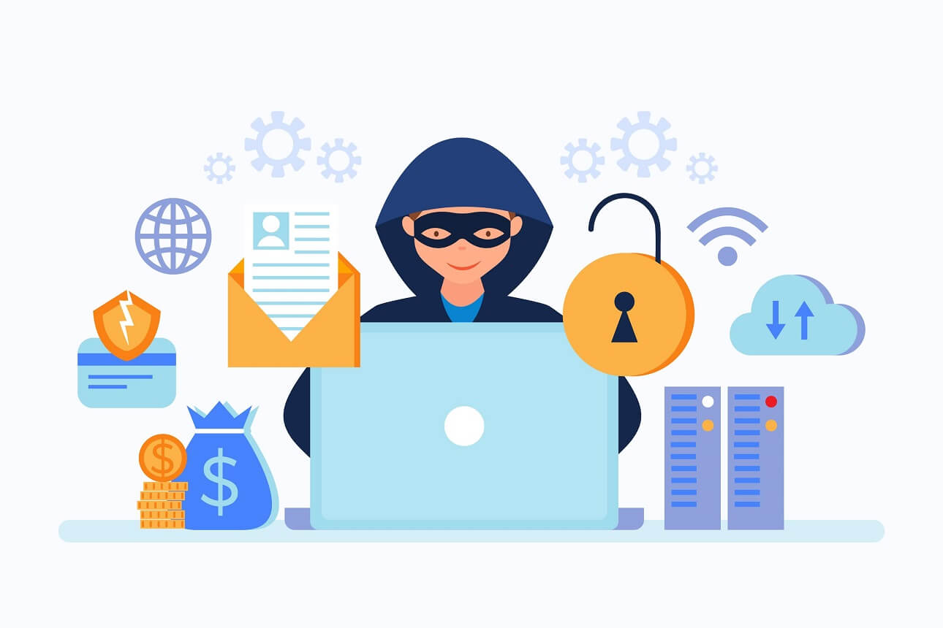
CASE STUDIES
Attack: Global Enterprises became the target of a sophisticated phishing attack where cybercriminals impersonated a trusted vendor. The attackers specifically targeted the finance department by sending urgent and convincing communications that requested changes to payment details for an outstanding invoice. Due to the urgency and apparent legitimacy of the request, the finance team unknowingly processed the fraudulent payment. This breach went unnoticed until the legitimate vendor reached out to inquire about the overdue payment, revealing the financial loss and causing significant disruption to vendor relationships.
Lessons Learned: In response to the incident, Global Enterprises implemented stronger vendor payment protocols that include multiple layers of verification and mandatory approvals before any payment details can be altered. They also introduced targeted, role-specific phishing awareness training for the finance team, focusing on recognizing common red flags such as unexpected urgency, changes in payment instructions, and verifying requests through trusted communication channels. These measures aim to reduce the risk of similar attacks by enhancing vigilance and establishing clear procedures for payment verification.

Slide 10
Real-World Phishing Example: The Fake Payment Alert
Phishing Attack: Cybercriminals posed as a trusted vendor to deceive Global Enterprises' finance team.
Deceptive Tactic: They sent urgent, convincing messages requesting changes to payment details.
Impact: The finance team unknowingly processed a fraudulent payment, resulting in financial loss and damaged vendor trust.
Detection: The scam was uncovered only when the legitimate vendor questioned the overdue payment.
Response: Global Enterprises strengthened payment protocols with multi-step verification and mandatory approvals.
Training: They launched targeted phishing awareness training for finance staff, highlighting how to spot red flags.
Verification: Emphasis was placed on confirming payment changes through trusted communication channels to prevent future attacks.

Slide 11
Stay Vigilant, Stay Protected
As cybercriminals continuously refine their techniques, phishing attacks will continue to evolve. However, our best defence lies in perpetual awareness and the consistent application of good cyber habits. Adopt a culture of cyber responsibility, both in your professional and personal life. Remember the golden rule: when in doubt, pause, verify through an independent channel, and never rush into clicking links or divulging information. By maintaining vigilance and adhering to these principles, we can collectively outsmart the scammers and safeguard our valuable data.

Slide 12
THANK YOU

